Slide 1
Noise pollution monitoring

Slide 2
Introduction
Air and sound pollution is a growing issue these days. It is necessary to monitor air quality and keep it under control for a better future and healthy living for all. Here we propose an air quality as well as sound pollution monitoring system that allows us to monitor and check live air quality as well as sound pollution in a particular areas through IOT. System uses air sensors to sense presence of harmful gases/compounds in the air and constantly transmit this data to microcontroller. Also system keeps measuring sound level and reports it to the online server over IOT.

Slide 3
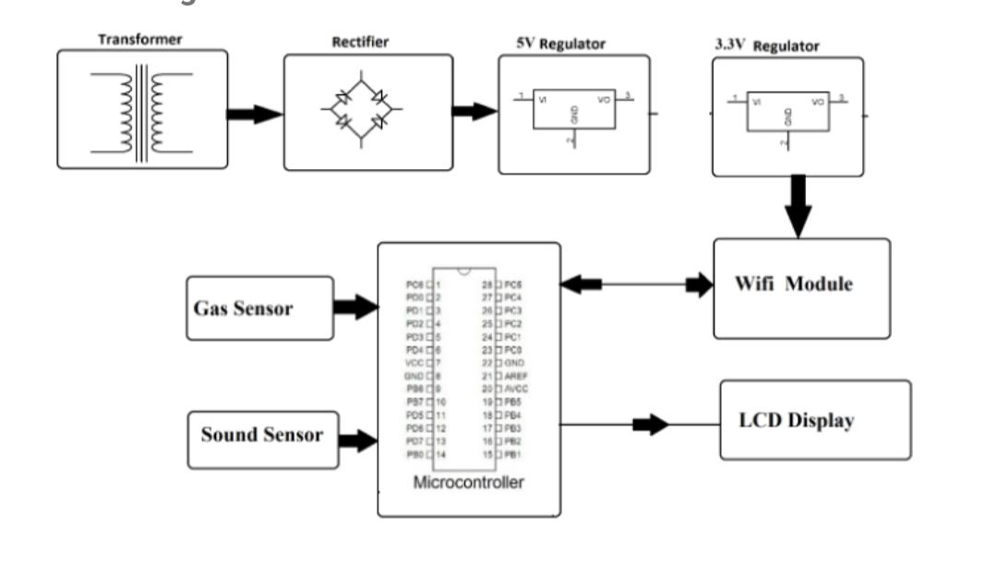
Block diagram

Slide 4
Hardware components
Atmega Microcontroller
MQ 135 Sensor
Mic Sensor
ESP8266 Wifi Module
LCD Display.
Diode
LED
Transformer/Adapter.

Slide 5
Atmega microcontroller
The Atmega microcontroller is a popular family of 8-bit microcontrollers developed by Atmel, now part of Microchip Technology. These microcontrollers are widely used in embedded systems and electronics projects. They feature various versions with different capabilities, including a range of flash memory sizes, GPIO pins, and communication interfaces. The Atmega microcontrollers are known for their versatility, ease of use, and compatibility with the Arduino platform.
MQ135 sensor
The MQ-135 sensor is a gas sensor module capable of detecting a variety of gases, including carbon dioxide (CO2), ammonia (NH3), methane (CH4), and various volatile organic compounds (VOCs) in the air. It operates based on the principle of changes in electrical conductivity of its tin dioxide (SnO2) semiconductor when exposed to different gases. The resistance of the sensor varies with gas concentration, allowing it to be used for air quality monitoring, gas leak detection, and indoor environmental monitoring.

Slide 6
LCD DISPLAY
LCD displays have become a ubiquitouswies, providing visual output for countless electronic devices.An LCD (Liquid Crystal Display) is a flat-panel display technology commonly used for visual output in electronic devices.
DIODE
In rectifiers, diodes play a crucial role in converting alternating current (AC) into direct current .Conversion of AC to DC: Diodes are semiconductor devices that allow the flow of electrical current in only one direction. In rectifiers, one or more diodes are used to control the flow of electrical current in a circuit.

Slide 7
ESP8266
The ESP8266 is a popular Wi-Fi module known for its versatility and cost-effectivenessThe microcontroller and Wi-Fi: The ESP8266 integrates a microcontroller and Wi-Fi connectivity, allowing it to connect to Wi-Fi networks and communicate with other devices and the internet.Low Cost: ESP8266 modules are known for their affordability, making them accessible for a wide range of IoT (Internet of Things) projects.P8266 is a popular Wi-Fi module known for its versatility and cost-effectiveness.
ADAPTER
An adapter, in a general sense, is a device or component that allows two or more incompatible parts or systems to work together by providing a bridge or interface between them. It functions to make connections or translations, ensuring compatibility and smooth operation between different devices or components.

Slide 8
Conclusion
In conclusion, a noise monitoring system represents a vital tool in our efforts to mitigate the adverse effects of noise pollution on our environment and well-beingThese systems not only contribute to quieter and healthier living environments but also promote sustainable urban planning, regulatory compliance, and the protection of ecosystems affected by excessive noise. In essence, noise monitoring systems exemplify the fusion of technology and environmental stewardship in our quest for a quieter, more harmonious world.

Slide 9
Thankyou....

